Slide 1
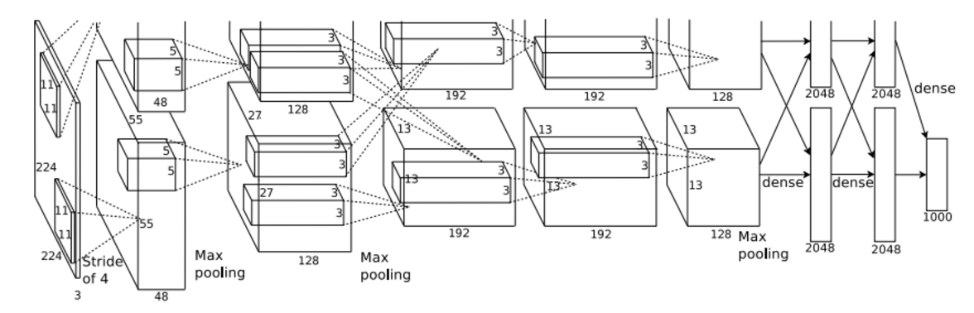
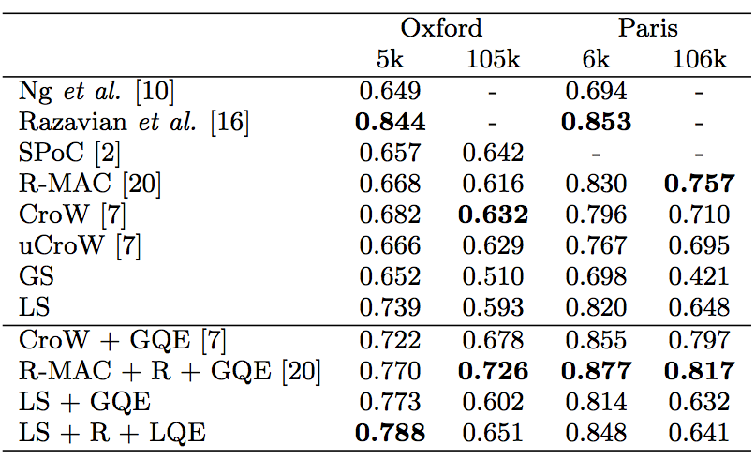

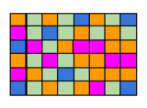
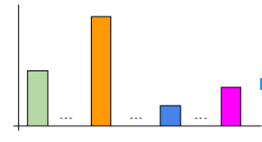
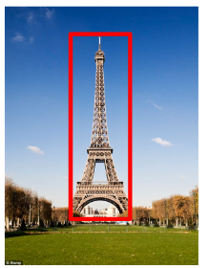
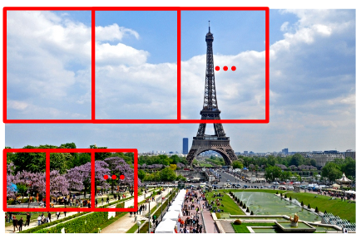
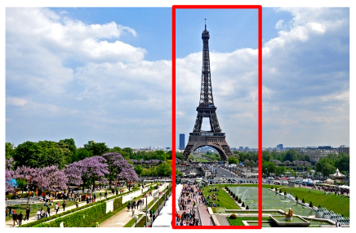
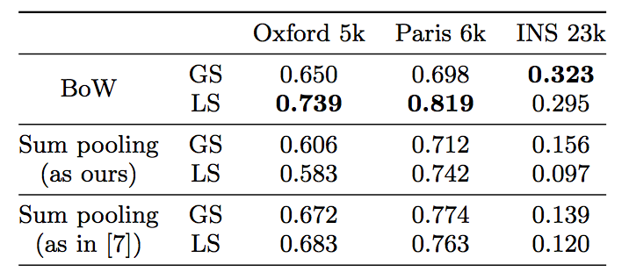
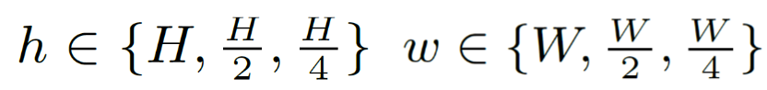
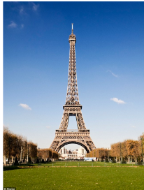
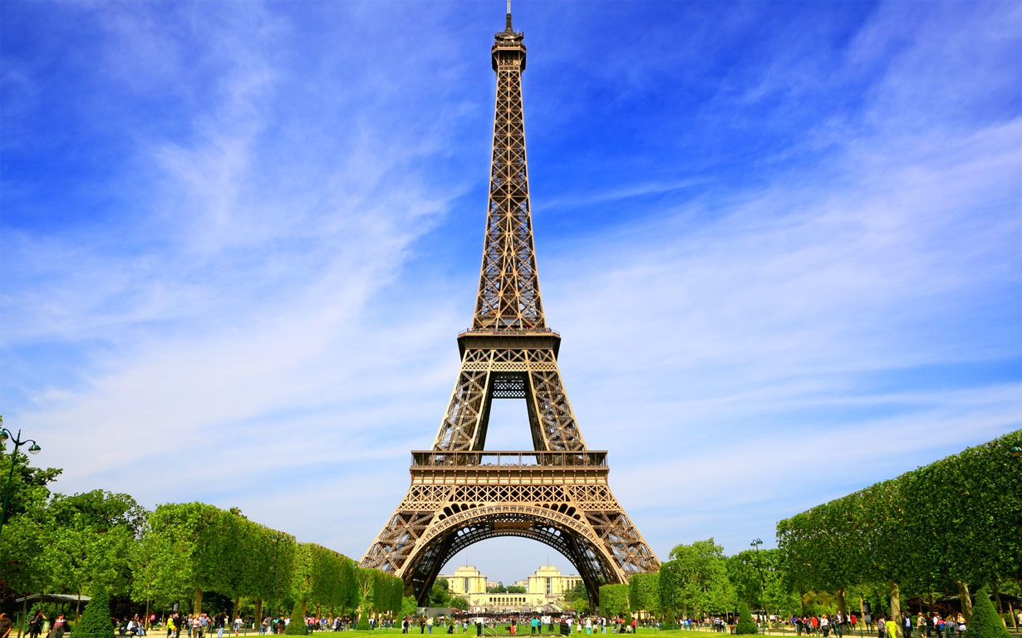
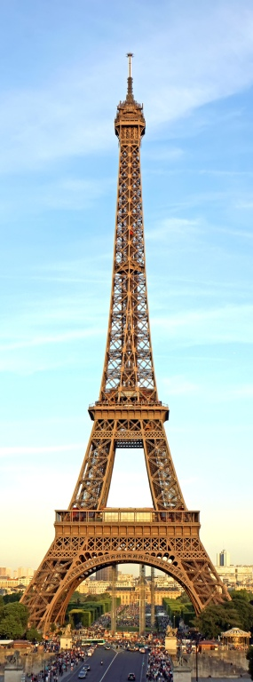
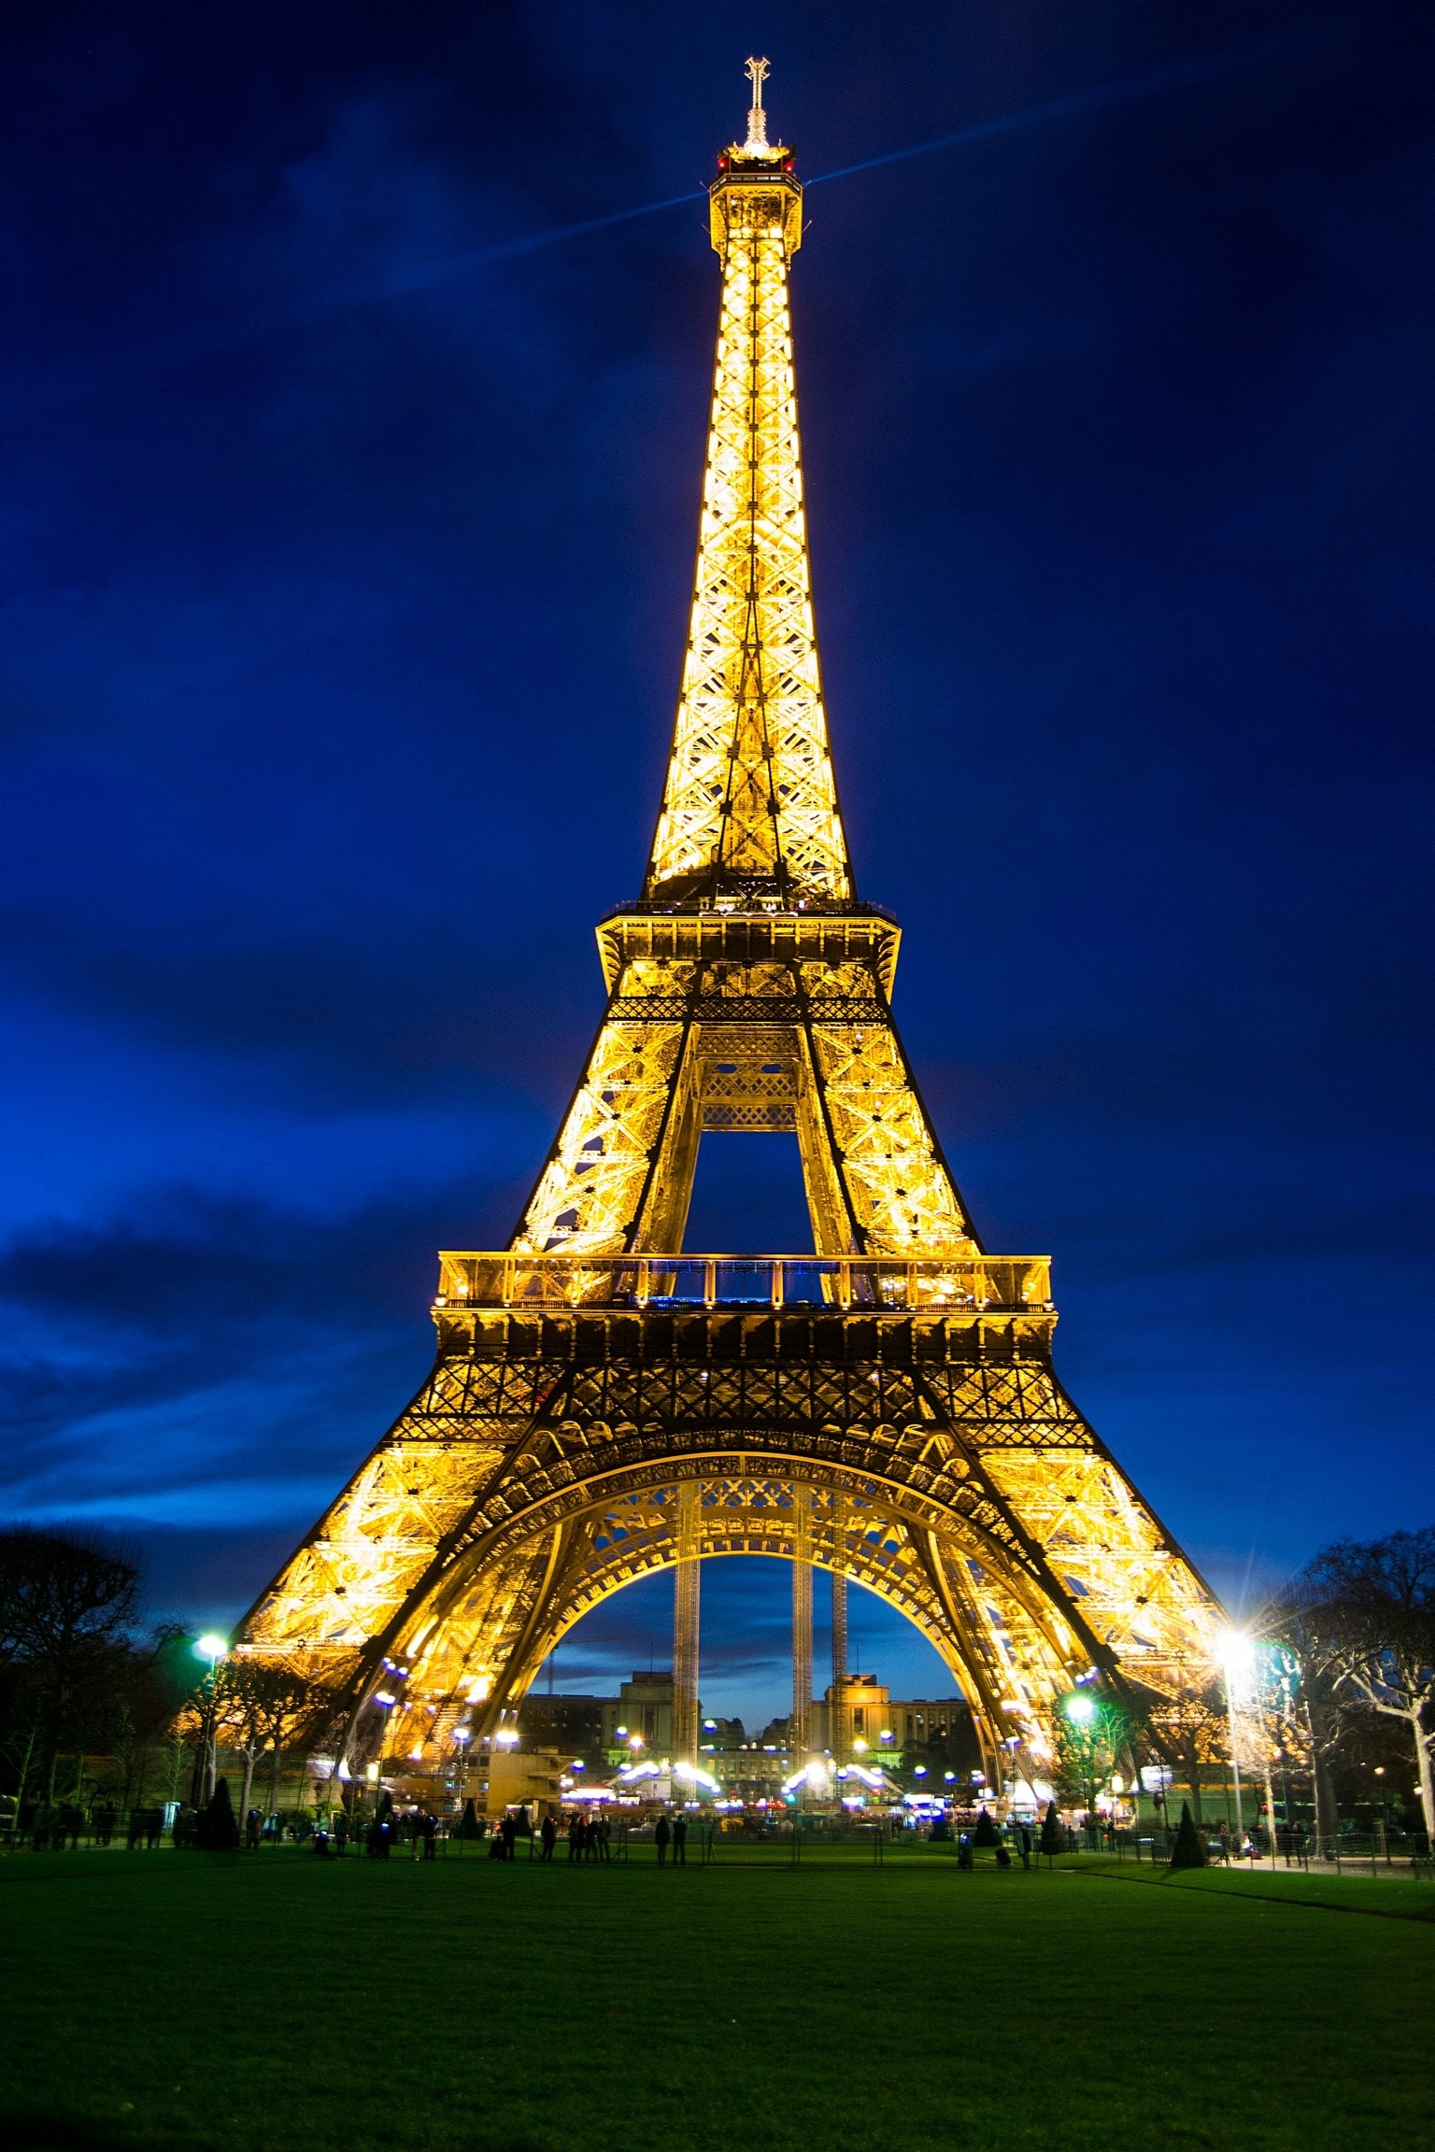
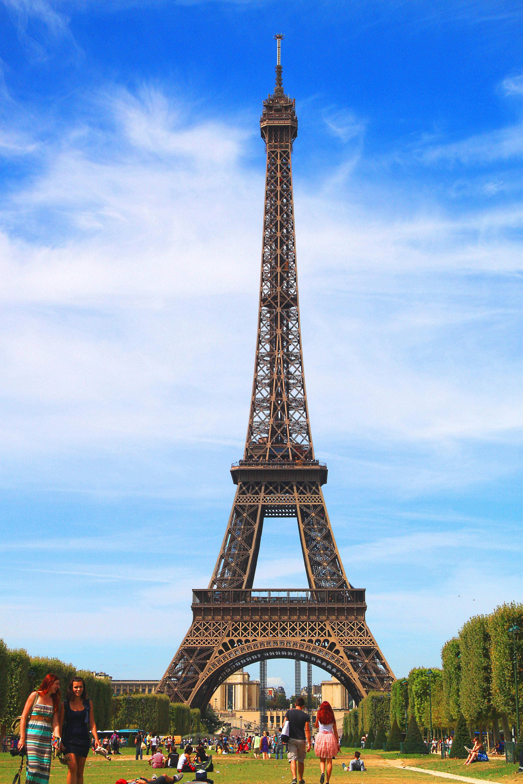
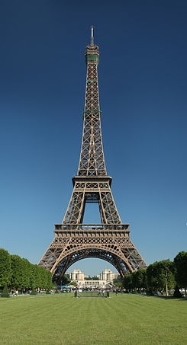
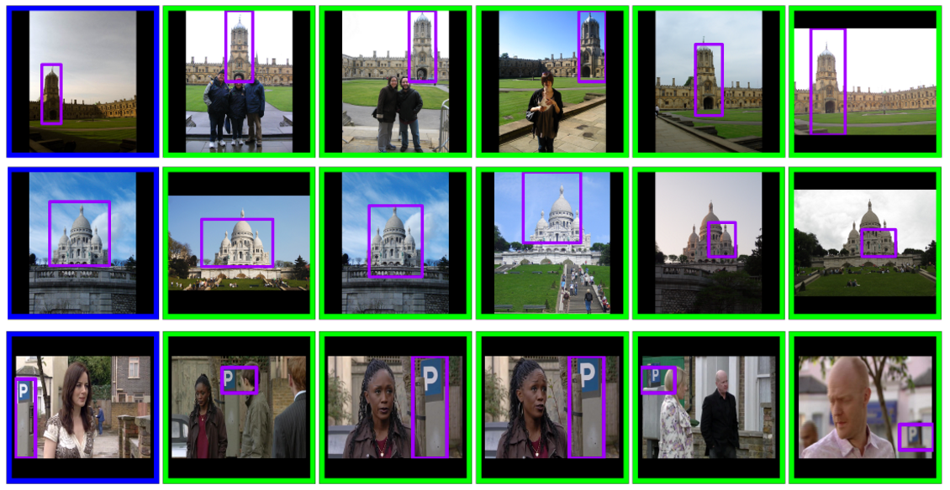
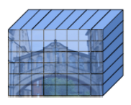
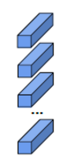
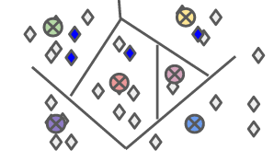
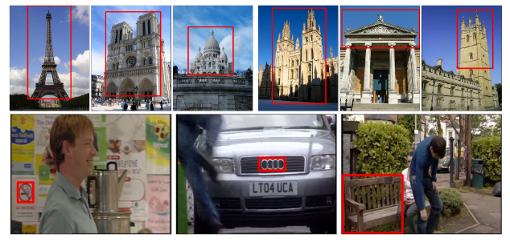

Bags of Convolutional Features for Scalable Instance Search
Eva Mohedano*, Amaia Salvador*, Kevin McGuinness, Ferran Marques, Noel E. O’Connor and Xavier Giró
Insight Centre for Data Analytics, Dublin City University
Universitat Politècnica de Catalunya
Motivation
Instance Retrieval
Experiments
CNN Features for Instance Search
Query Representation
Comparison with state-of-the-art
Global Search (GS)
Dataset
Rank list
fc layers as global features representations
Local Search (LS)
Cosine
Similarity
.
.
sum/max pooled conv features as global representations
conv features encoded with VLAD as global representation
.
Compact & Dense
(e.g. sum/max pooling conv feats, FC feats)
Capacity?
High-dimensional & Dense
(e.g. VLAD encoding)
Scalability?
Spatial Reranking
High-dimensional & Sparse
Rank list
Query Image
Target Image in top N
Results on TRECVID subset
Bag of Visual Words
Analyse top N results
N=100
.
.
.
Contributions
Windows with:
Sparse visual representation based on a Bags of Convolutional Features, which allows fast retrieval by means of an inverted index.
Assignment map as a new compact representation of the image, allowing fast composition of BoW descriptor for any region of the image.
Local analysis of multiple image regions for reranking followed by query expansion using the obtained object locations.
Query Expansion
Rank list
New Query
.
.
.
Original Query
Top 5 images
Bag of Words framework
Datasets
Paris Buildings 6k
Oxford Buildings 5k
Image
(336x256)
Conv Layer
conv5_1,VGG16
(42x32)
Local CNN features
1344 feats, 512D
Visual Vocabulary
25k centroids
Conclusions
High-dimensional sparse representation suitable for fast retrieval
Competitive results in two image retrieval benchmarks
Well suited and more robust for scenarios where only small number of features in the target images are relevant to the query.
Assignment Map
(42x32) visual words
BoW vector
25k dimensions.
TRECVID Instance Search Subset 2013
(subset of 23k frames)

